Slide 1
Selection sort

Slide 2
Outline
In this lesson, we will:
Describe the selection sort algorithm
Look at an example
Determine how the algorithm work
Create a flow chart
Implement the algorithm
Look at the run times

Slide 3
The idea
Suppose we have an array and we’d like to sort it:
Consider the following algorithm:
Find the largest entry in the array and swap it with the last entry
Next, find the largest remaining entry in the array and swap it with the second-last entry
Proceeding forward, we can continue until the entire array is sorted

Slide 4
Example
For example, consider this array:
We start by swapping 85 and 7:
0 | 1 | 2 | 3 | 4 | 5 | 6 | 7 | 8 | 9
82 | 25 | 42 | 85 | 16 | 32 | 42 | 4 | 28 | 7
0 | 1 | 2 | 3 | 4 | 5 | 6 | 7 | 8 | 9
82 | 25 | 42 | 7 | 16 | 32 | 42 | 4 | 28 | 85

Slide 5
Example
Next, we find the largest remaining entry at index 0:
We swap 82 and 28:
0 | 1 | 2 | 3 | 4 | 5 | 6 | 7 | 8 | 9
82 | 25 | 42 | 7 | 16 | 32 | 42 | 4 | 28 | 85
0 | 1 | 2 | 3 | 4 | 5 | 6 | 7 | 8 | 9
28 | 25 | 42 | 7 | 16 | 32 | 42 | 4 | 82 | 85

Slide 6
Example
Next, we find the largest remaining entry at index 2:
We swap 42 and 4:
0 | 1 | 2 | 3 | 4 | 5 | 6 | 7 | 8 | 9
28 | 25 | 42 | 7 | 16 | 32 | 42 | 4 | 82 | 85
0 | 1 | 2 | 3 | 4 | 5 | 6 | 7 | 8 | 9
28 | 25 | 4 | 7 | 16 | 32 | 42 | 42 | 82 | 85

Slide 7
Example
Next, we find the largest remaining entry at index 6:
We swap it and itself
0 | 1 | 2 | 3 | 4 | 5 | 6 | 7 | 8 | 9
28 | 25 | 4 | 7 | 16 | 32 | 42 | 42 | 82 | 85
0 | 1 | 2 | 3 | 4 | 5 | 6 | 7 | 8 | 9
28 | 25 | 4 | 7 | 16 | 32 | 42 | 42 | 82 | 85

Slide 8
Example
After nine steps, we will have a sorted list
0 | 1 | 2 | 3 | 4 | 5 | 6 | 7 | 8 | 9
4 | 7 | 16 | 25 | 28 | 32 | 42 | 42 | 82 | 85

Slide 9
Swapping
Previously we have seen how to swap two array entries:
double tmp{array[m]};
array[m] = array[n];
array[n] = tmp;
The Standard Template Library (stl) implements this function:
std::swap( array[m], array[n] );
There is no point in re-inventing the wheel, so to speak
However, you may still be required to understand swapping on the final examination…

Slide 10
Selection sort
Let’s step through the algorithm for an array of capacity 10:
Find the largest entry between 0 and 9 and swap it with entry 9
Find the largest entry between 0 and 8 and swap it with entry 8
Find the largest entry between 0 and 7 and swap it with entry 7
Find the largest entry between 0 and 6 and swap it with entry 6
Find the largest entry between 0 and 5 and swap it with entry 5
Find the largest entry between 0 and 4 and swap it with entry 4
Find the largest entry between 0 and 3 and swap it with entry 3
Find the largest entry between 0 and 2 and swap it with entry 2
Find the largest entry between 0 and 1 and swap it with entry 1
At this point, the array is sorted

Slide 11
Finding the maximum
Let us rewrite our find_max(…) function to follow the spirit of our searching algorithms:
Rather than returning the maximum, return the index of the maximum entry
std::size_t find_max( double const array[],
std::size_t const begin,
std::size_t const end ) {
std::size_t index_max{begin};
for ( std::size_t k{begin + 1}; k < end; ++k ) {
if ( array[k] > array[index_max] ) {
index_max = k;
}
}
return index_max;
}

Slide 12
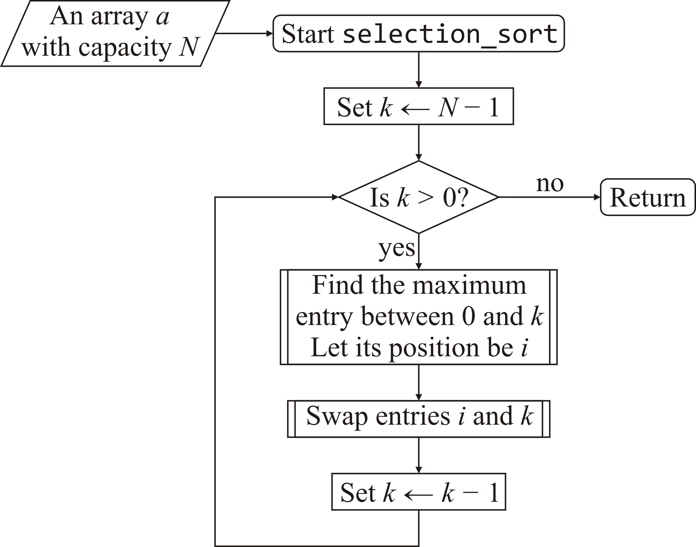
Selection sort
Here is a flow chart:

Slide 13
Selection sort
Let us implement this function:
void selection_sort( double array[], std::size_t const capacity ) {
for ( std::size_t k{capacity - 1}; k > 0; --k ) {
// ???
std::swap( array[index_max], array[k] );
}
}

Slide 14
Selection sort
Finding the maximum entry is something we’ve already done:
void selection_sort( double array[], std::size_t const capacity ) {
for ( std::size_t k{capacity - 1}; k > 0; --k ) {
std::size_t index_max{find_max( array, 0, k + 1 )};
std::swap( array[index_max], array[k] );
}
}
This is our first sorting algorithm

Slide 15
Selection sort
We could even generalize it to sort a sub-array:
void selection_sort( double array[],
std::size_t const begin,
std::size_t const end ) {
for ( std::size_t k{end - 1}; k > begin; --k ) {
std::size_t index_max{ find_max( array, begin, k + 1 ) };
std::swap( array[index_max], array[k] );
}
}

Slide 16
Run time
How long does this take to run?
For an array of size 10:
We check 10 entries, and perform 1 swap
We check 9 entries, and perform 1 swap
We check 8 entries, and perform 1 swap
We check 7 entries, and perform 1 swap
We check 6 entries, and perform 1 swap
We check 5 entries, and perform 1 swap
We check 4 entries, and perform 1 swap
We check 3 entries, and perform 1 swap
We check 2 entries, and perform 1 swap
We don’t have to check one entry: the first entry is the smallest

Slide 17
Run time
How much work did we do?
We checked 10 + 9 + 8 + 7 + 6 + 5 + 4 + 3 + 2 = 54 entries
We swapped 9 pairs of entries
If our array had n entries, we would have to:
Check
We swapped n – 1 pairs of entries
Sorting an array of size one million requires that
(half a trillion) entries be checked with 999 999 swaps
This could be rather slow…

Slide 18
Run time
For very large arrays, note that
is very close to
For example:
You will investigate this further in your algorithms and data structures course

Slide 19
Benefits
The run time does not change even if the array is already sorted
The one benefit of selection sort over all other sorts is that it minimizes the number of writes to memory to 2n – 2 writes
No other sorting algorithm comes close
Useful for flash memory which has a limited number of writes

Slide 20
Summary
Following this lesson, you now
Understand the selection sort algorithm
You saw an example
Know how stepping through the algorithm allows you to deduce the flow chart
Understand how to implement the algorithm
Know that there is a significant number of entries that must be inspected for large arrays:
Approximately half the capacity squared

Slide 21
References
[1] Wikipedia
https://en.wikipedia.org/wiki/Selection_sort
[2] nist Dictionary of Algorithms and Data Structures
https://xlinux.nist.gov/dads/HTML/selectionSort.html

Slide 22



Colophon
These slides were prepared using the Georgia typeface. Mathematical equations use Times New Roman, and source code is presented using Consolas.
The photographs of lilacs in bloom appearing on the title slide and accenting the top of each other slide were taken at the Royal Botanical Gardens on May 27, 2018 by Douglas Wilhelm Harder. Please see
https://www.rbg.ca/
for more information.

Slide 23
Disclaimer
These slides are provided for the ece 150 Fundamentals of Programming course taught at the University of Waterloo. The material in it reflects the authors’ best judgment in light of the information available to them at the time of preparation. Any reliance on these course slides by any party for any other purpose are the responsibility of such parties. The authors accept no responsibility for damages, if any, suffered by any party as a result of decisions made or actions based on these course slides for any other purpose than that for which it was intended.

